Slide 1
Crowd-sourced Alpha: The Search for the Holy Grail of Investing
Jessica Stauth, PhD – VP Quant Strategy
Justin Lent, Director of Fund Development
Thomas Wiecki, PhD – Lead Data Scientist
Notes:
Hi everyone, thanks for joining us this morning. My name is Jess Stauth and I run the quant research team at Quantopian.
The research I’ll talk about today was done largely by Thomas Wiecki and Justin Lent, who some of you might know or have seen in the forums.

Slide 2
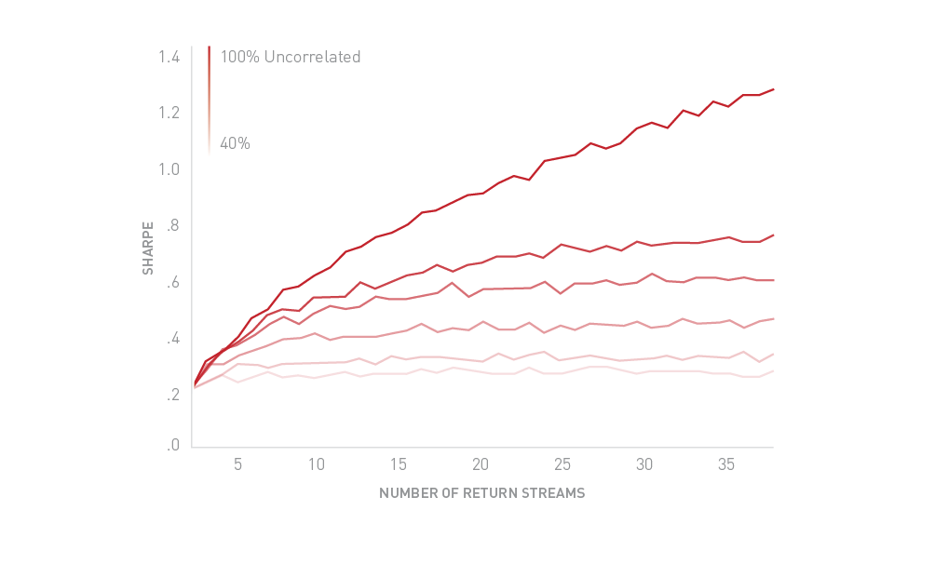
Uncorrelated returns streams are the Holy Grail of investing. – Ray Dalio*
*http://www.scribd.com/doc/134432415/Ray-Dalio-Whats-Going-on-in-the-World-Presentation-pdf#scribd
Notes:
The cornerstone of the approach I’ll talk about today is based on this nice ‘pseudoquote’ from Ray Dalio: “Uncorrelated returns streams are the holy grail of investing.”
This plot shows results from a simple simulation that illustrates what we mean by that. The X-axis indicates the number of returns streams combined in your portfolio, starting from 1 asset on the far left and growing to 40 at the far right. The Y-axis shows the resulting portfolio level Sharpe ratio achieved, assuming that each return stream has a consistent sharpe. All that changes as you walk up the curves from the lightest to darkest red curve is a decreasing level of correlation between the returns streams. The top, darkest red line assumes perfectly uncorrelated assets.
Another way of describing this effect is simply the benefits of diversification. Adding more assets or returns streams to my portfolio results in diversification only to the extent that the new assets are truly ‘new’ and are not just ‘more of the same’.
Looks pretty straight-forward right? NEXT

Slide 3
Why is it so hard to find the Holy Grail?
Positive Sharpe returns streams are a moving target – requires ongoing research efforts to keep finding the holy grail over and over.
Most investment teams are ‘narrow and deep’ in terms of expertise, making it challenging to surface new uncorrelated strategies.
Large multi-manager firms can be extremely successful (Millenium, Highbridge, Barclays nQuants), BUT…
The barriers to entry with a traditional model are high.
Quantopian has a non-traditional model: crowdsourcing.
Notes:
Read slide.

Slide 4
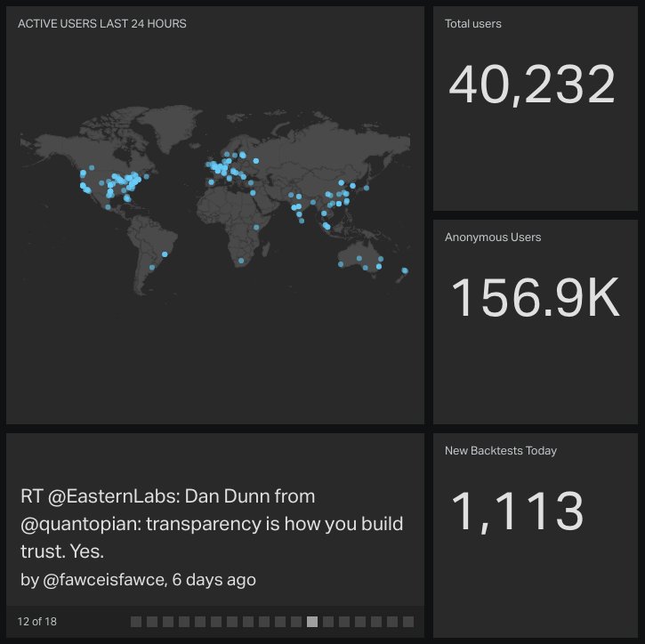
Crowdsourcing – the process of obtaining needed services, ideas or content by soliciting contributions from a large group of people, and especially an online community, rather than from traditional employees or suppliers.
http://en.wikipedia.org/wiki/Crowdsourcing
Notes:
As a quick refresher, the definitive source of truth (wikipedia) defines crowd-sourcing as – the process of obtaining needed services, ideas or content by soliciting contributions from a large group of people, and especially an online community, rather than from traditional employees or suppliers.
That describes Quantopian quite well. Our online community is made up of 40,000 registered users and growing every day. Over half of you are based outside of the US.
You can get a feel for from this geolocation snapshot for a recent 24 hour period.
So given that we have the power of the crowd, the next question really becomes, how do we engage the crowd in providing this service, namely the creation of uncorrelated returns streams? They’ve got to have some incentive for contributing.

Slide 5
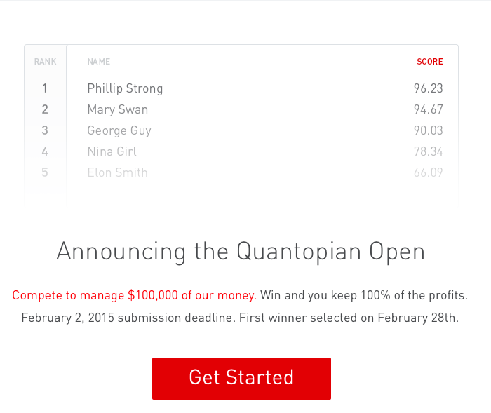
The Quantopian Open launched in January 2015
Notes:
To offer a tangible incentive we launched our first paper trading competition, the Quantopian Open, this past July.
For those you you might not have heard about it, the Open is a paper trading competition where each month we award a $100k prop trading account to the winning algorithm. The winning algorithm runs against our account for 6 months, at the end of which the author keeps 100% of the profits earned.
NEXT

Slide 6
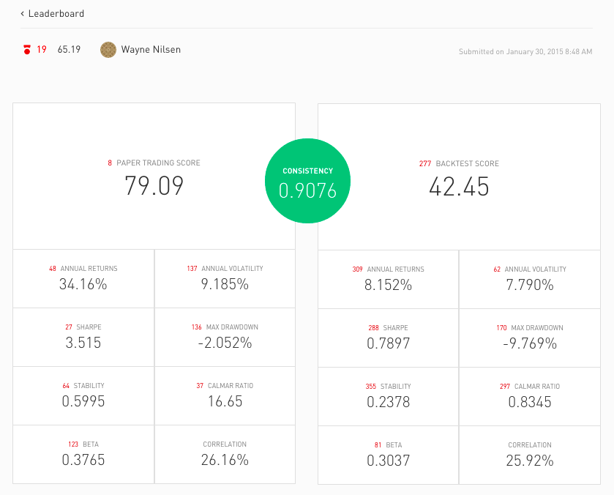
The Quantopian Open launched in January 2015
Notes:
Currently we rank all algorithms entered into the contest across 7 measures (which do have some overlap), Annual returns, volatility, sharpe, drawdown, stability, calmar ratio and beta. We also display, but don’t currently rank on average pairwise correlation to other algorithms in the contest.
We view the Open as a laboratory for iteration and testing of our automated selection process. For example, in the second month of the contest we added a consistency measure that looks across scores for backtest data versus out of sample live trading data.
NEXT

Slide 7
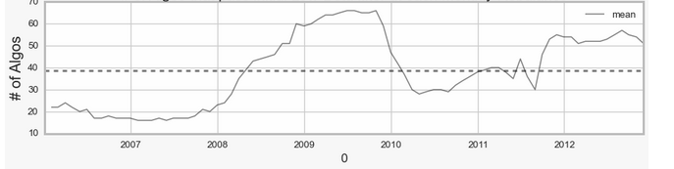
Many of the algorithms submitted to the Open show strong correlation to the market, and consequently to each other. In a historical simulation only 20-60 algorithms passed our maximum threshold for correlation per month.
We need a larger pool of uncorrelated returns streams for the fund. Last month we adjusted the contest rules accordingly...
Notes:
READ SLIDE.

Slide 8
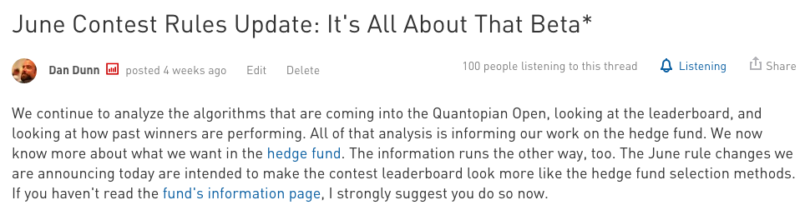
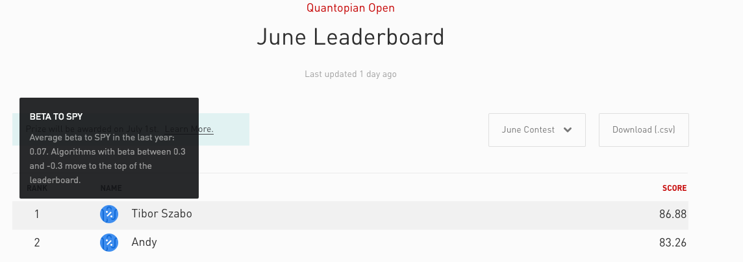
Notes:
In May we announced a scoring change in the contest to attract a larger pool of uncorrelated algorithms. We introduced a ‘beta badge’ and moved all algorithms with a trailing 12 month beta to spy of < +/-0.3 to the top of the leaderboard.
We’re seeing signs that the ‘crowd’ is starting to move in the right direction. But it’s still early and there is a huge opportunity right now to get out in front, win the contest and get your strategy into the fund.
Up next I’m going to talk a bit more the things we are looking FOR when selecting algorithms for the fund.

Slide 9
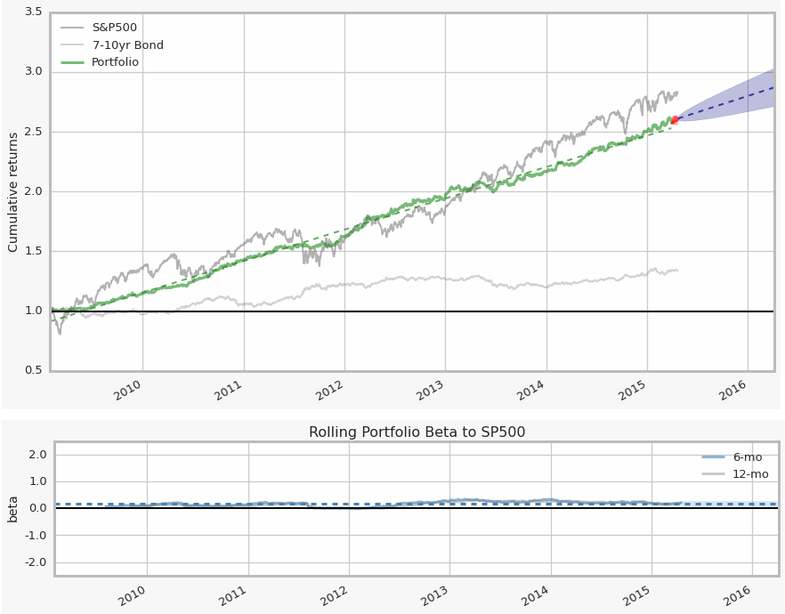
What we look for: Low Exposure to the Market
We want algorithms that aren't correlated to the rest of the stock market. We are looking for algorithms with a market beta between -0.3 and +0.3.

Slide 10
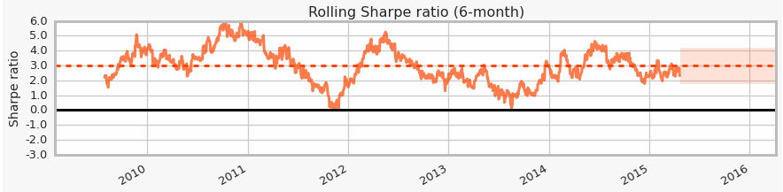
What we look for: Consistent Profitability
We want algorithms that show stable profits. If your algorithm is losing money, or makes money in a volatile way, it isn't very helpful. We are looking for algorithms that consistently have a Sharpe ratio over 1.0.

Slide 11
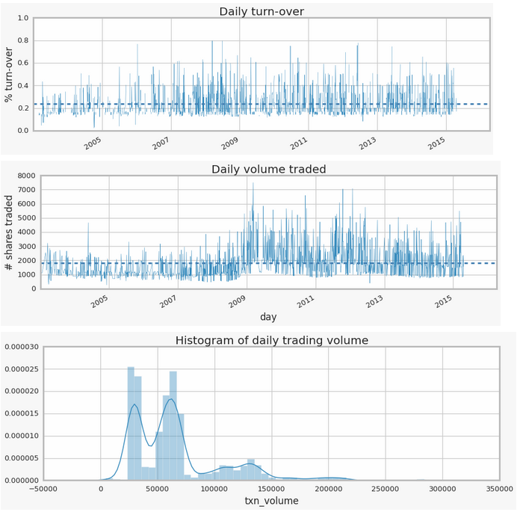
What we look for: Active Trading
Your algorithm has to actively trade. We measure that by looking at how often your portfolio turns over per year. We are looking for algorithms that turn over their portfolio between 12 and 500 times/year.

Slide 12
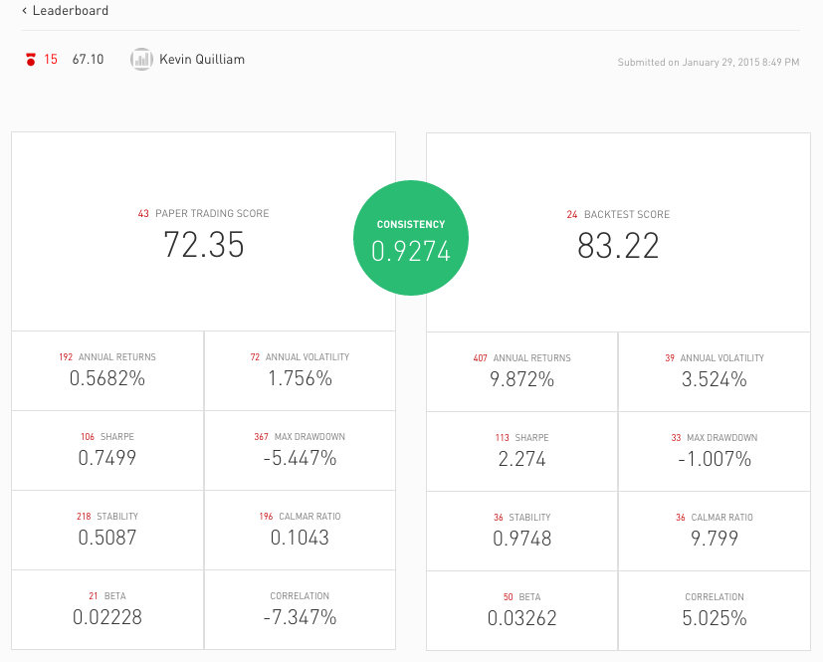
What we look for: Low Correlation to Peers
We look for algorithms with between -30% and +30% average pairwise correlation with the other algorithms in our portfolio.

Slide 13
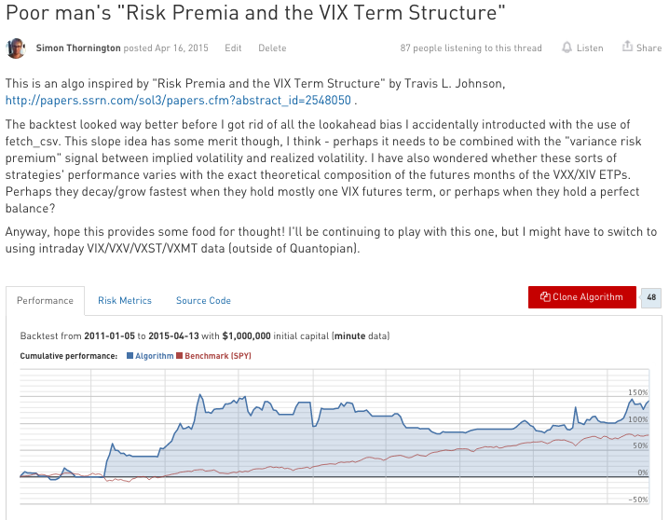
What we look for: Strategic Intent
We are are looking for algorithms that are driven by underlying economic reasoning.
Notes:
Examples of economic reasoning could be a supply and demand imbalance, a mixture of technical and fundamental drivers of stock price or a structural mispricing between an index ETF and its constituent stocks.
This is a tricky one to bake into an automated selection model of course. In a world where we use a manual overlay to select algorithms (which is certainly going to be true at least initially in selecting algorithms for our fund) we can talk with the algorithm author to understand this aspect. I’ll pick on Simon for a moment, in a good way, since

Slide 14
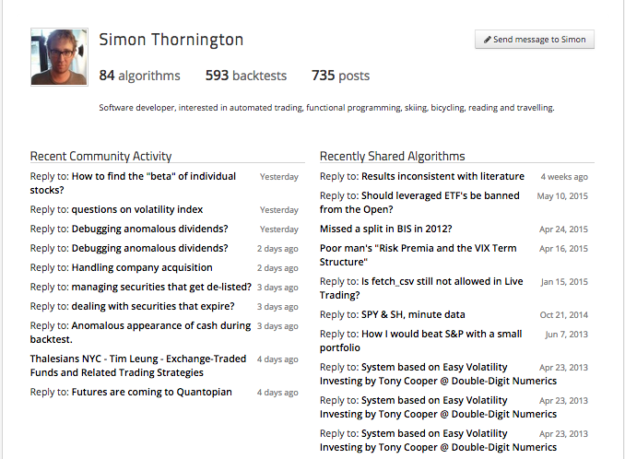
What we look for: Strategic Intent

Slide 15
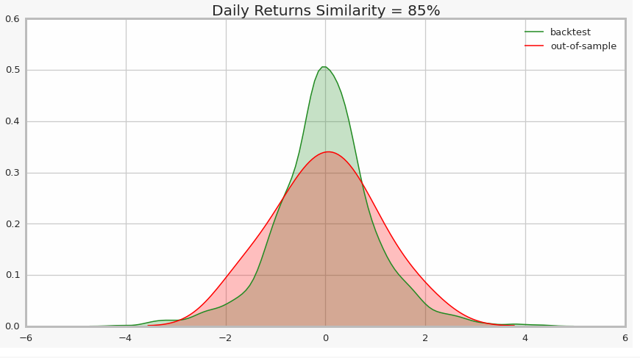
What we don’t look for…
Overfitting
Data snooping
Spurious correlations
CONSISTENCY
0.85

Slide 16
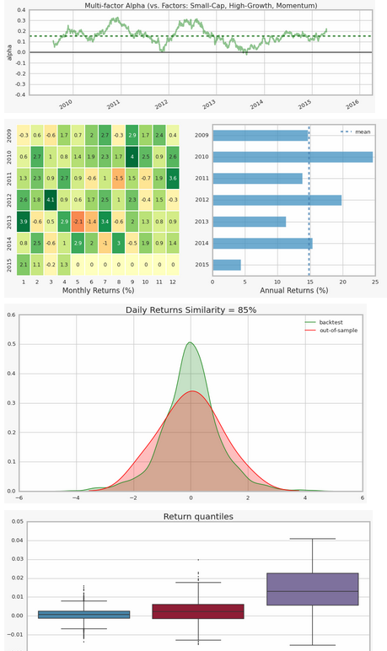
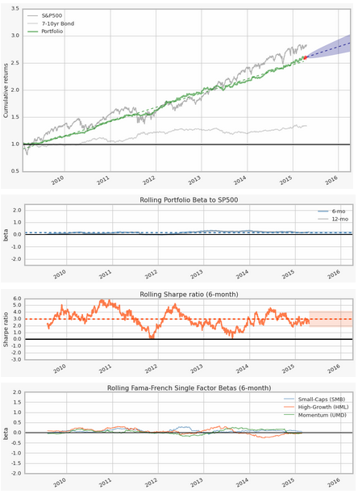
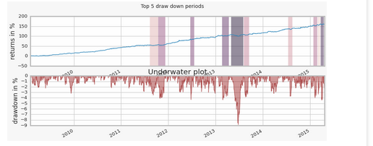
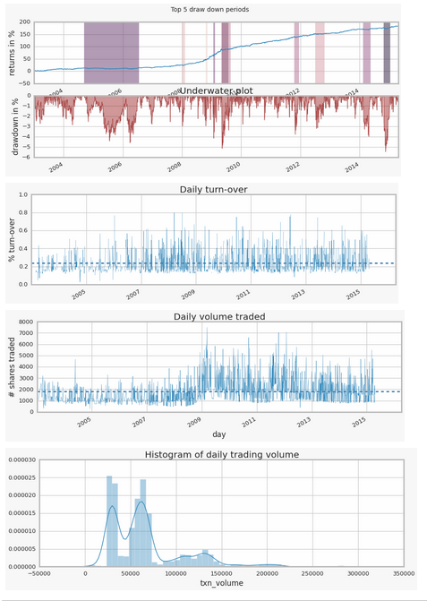
To help you better analyze your algo and get into the fund…
We’ll give you the same tear sheet analysis we built in-house to evaluate our own portfolio.
Coming soon to /research …

Slide 17
Your algorithm gets selected for the fund, what happens now?
You license your algorithm to Quantopian for use in our fund.
You get paid a 10% royalty based on the profits earned by your algorithm.
You retain ownership of your intellectual property.
Quantopian takes responsibility for operating your algorithm, allocating capital, and managing risk.

Slide 18
www.quantopian.com/open
Thank you. Questions?

Slide 19
Appendix Do not distribute V

Slide 20
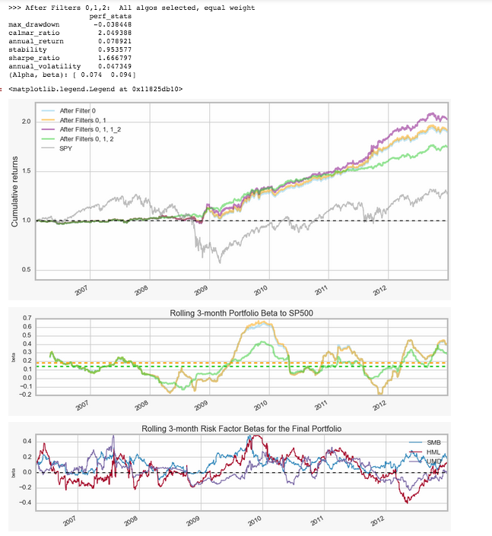
Equal-weight Portfolio Construction
In-sample walk-forward model results, ~200 algorithms submitted to Quantopian Open paper trading competition. Backtested time range: 2002-2012

Slide 21
Quantopian Open Submissions Cohort study
Top down analysis data set
~400 algorithms
Contest scores based on 1/2013 – 1/2015 backtest
Full backtest run from 1/2002 – 1/2015
Initial capital base $100k per algorithm
Default volume share slippage and t-costs ($0.03/share, $1 min/trade)
Hold out sample
50% of algorithms
Contest scoring period (1/2013-1/2015) for all algorithms

Slide 22
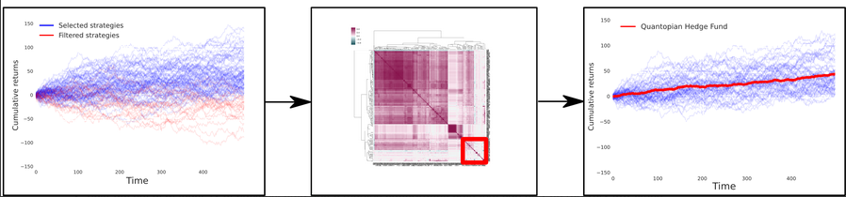
Algorithm Selection Model Design
1) Performance and Risk based Qualification
2) Anti-Correlation Qualification
3) Portfolio Construction
Simulated Results

Slide 23
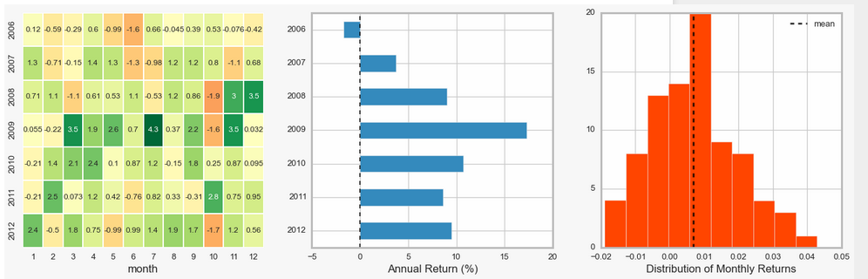
Equal-weight Portfolio Construction
In-sample walk-forward model results, ~200 algorithms submitted to Quantopian Open paper trading competition. Backtested time range: 2002-2012

Slide 24
Looks good so… we’re done right?
Wrong.

Slide 25
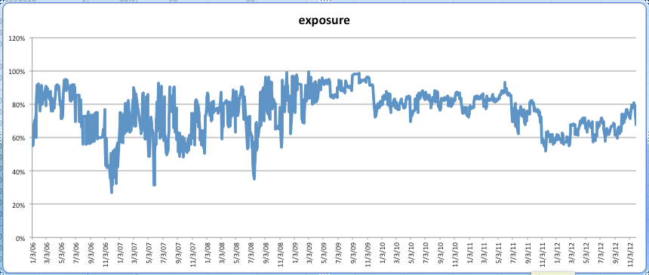
Without explicit hedging the simulated portfolio is long biased.

Slide 26
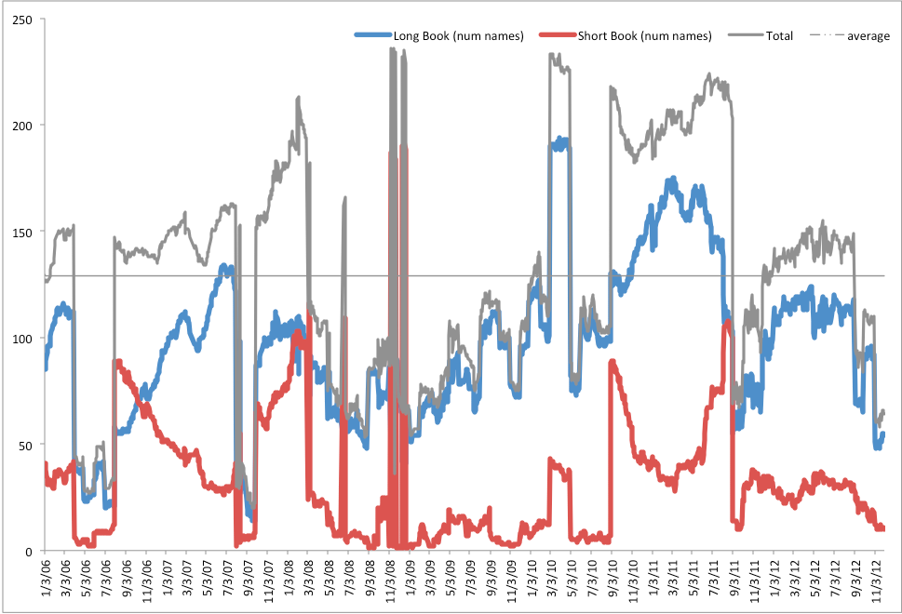
The simulated portfolio holds on average many fewer short positions than long positions.

Slide 27
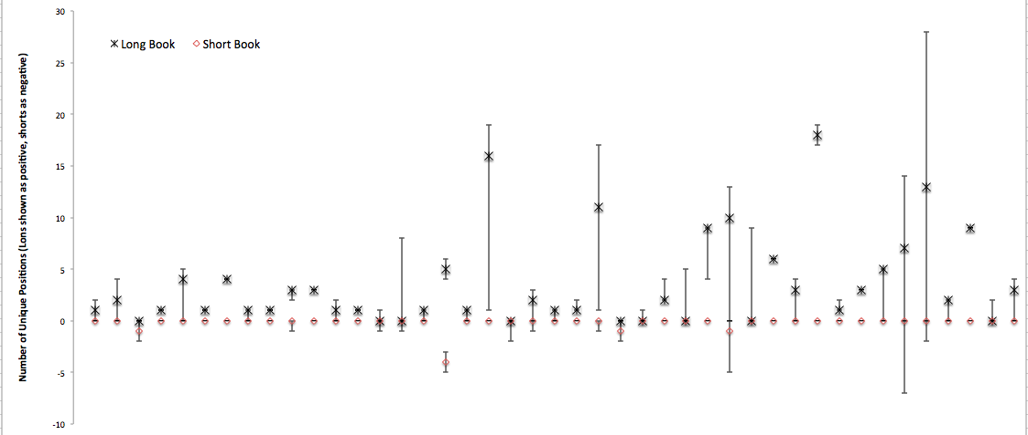
A sampling of several dozen individual algos shows that most algos hold more longs than shorts.

Slide 28
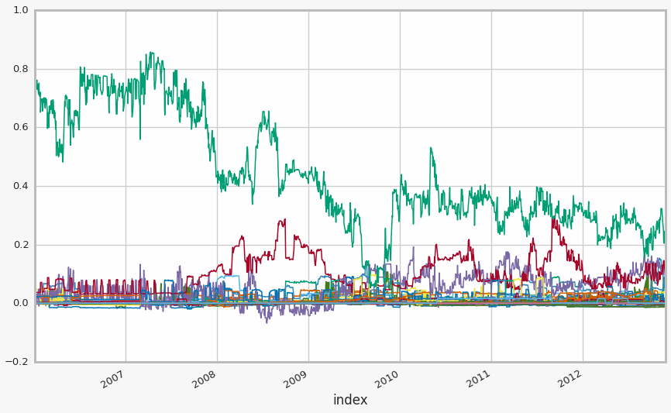
Without explicitly managing cash the global portfolio has large & varying cash exposure over time.
- cash

Slide 29
Cohort study conclusion: Fully automated selection model run over January contest cohort not ready for prime time.
Market risk: Need more low beta strategies. Only ~ 40 algos pass the beta filter each month, even fewer in the first year of the simulation.
Exposure risk: Without explicitly hedging on a per algo, or a global basis – the simulated portfolio is long biased.
Concentration risk: The global simulated portfolio holds on average many fewer short positions than longs, and on average holds ~130 names in total.
Cash management: Without explicitly managing cash at the global level, the portfolio holds large & varying cash exposures over time.

Slide 30
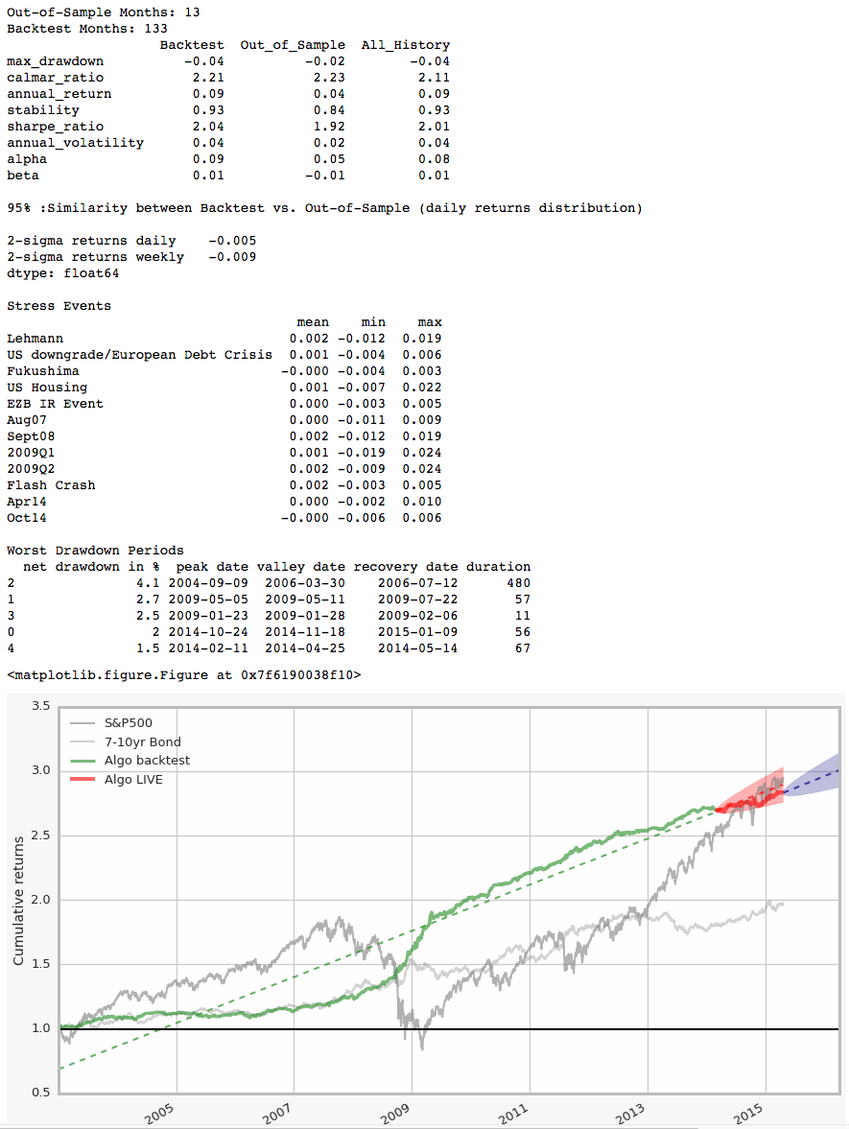
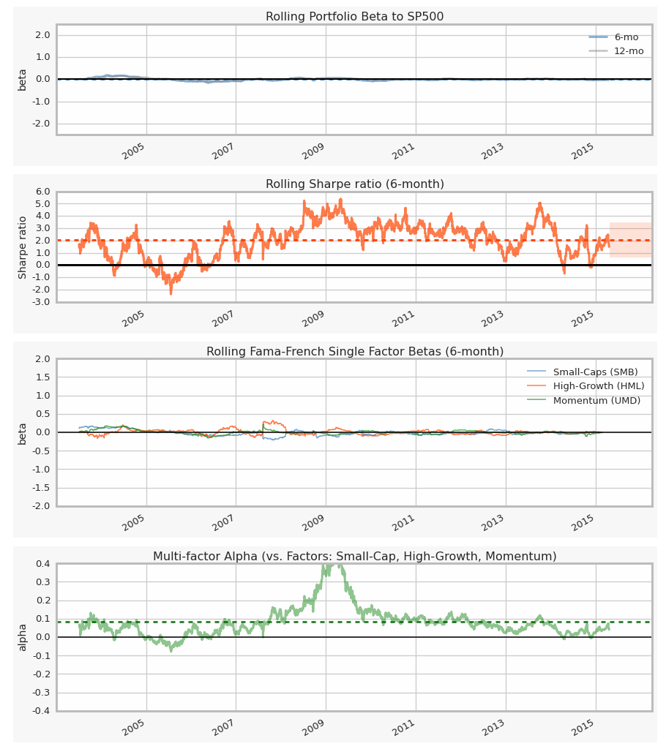
However, Bottom up “Tear sheet” analysis yields a number of compelling individual algorithms.

Slide 31
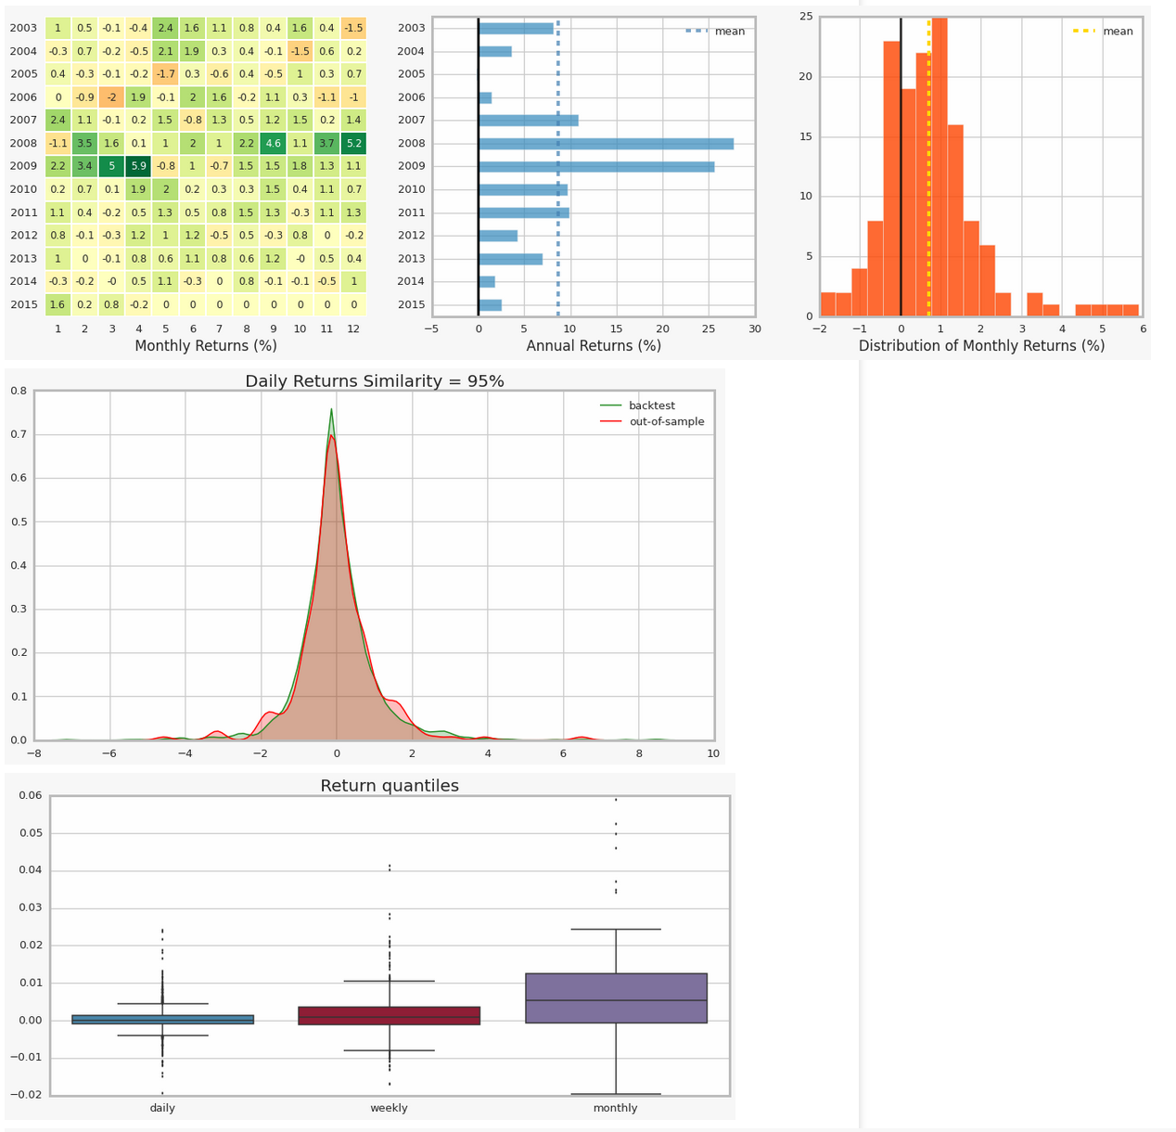
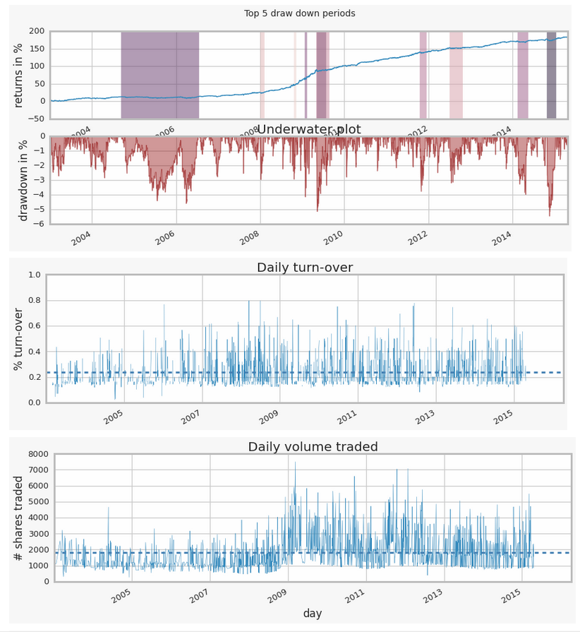
Tear Sheet analysis cont’d

Slide 32
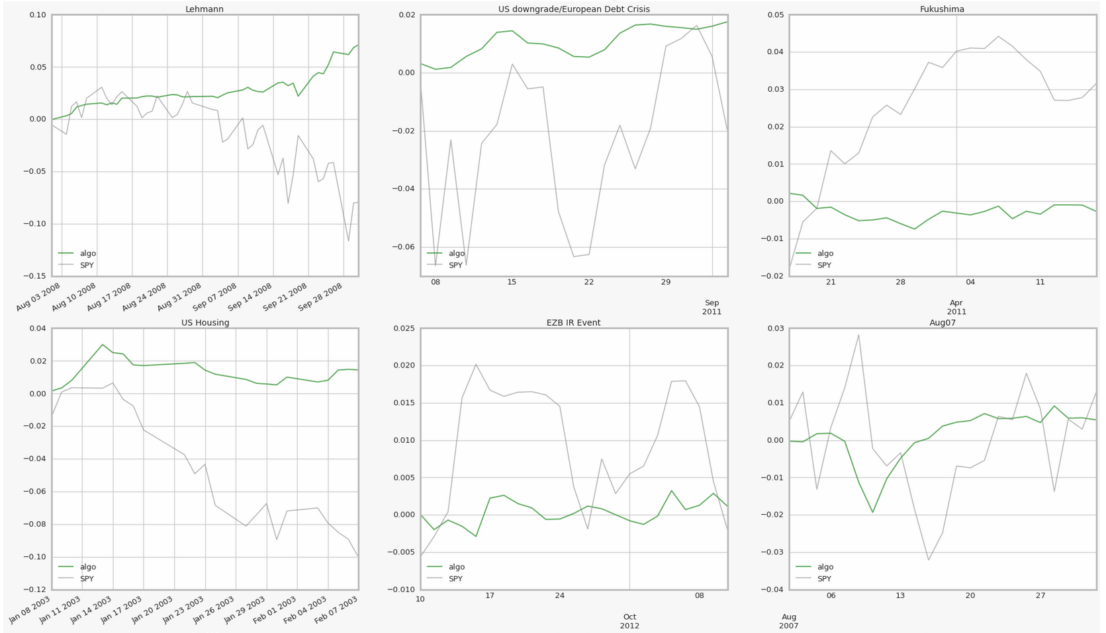
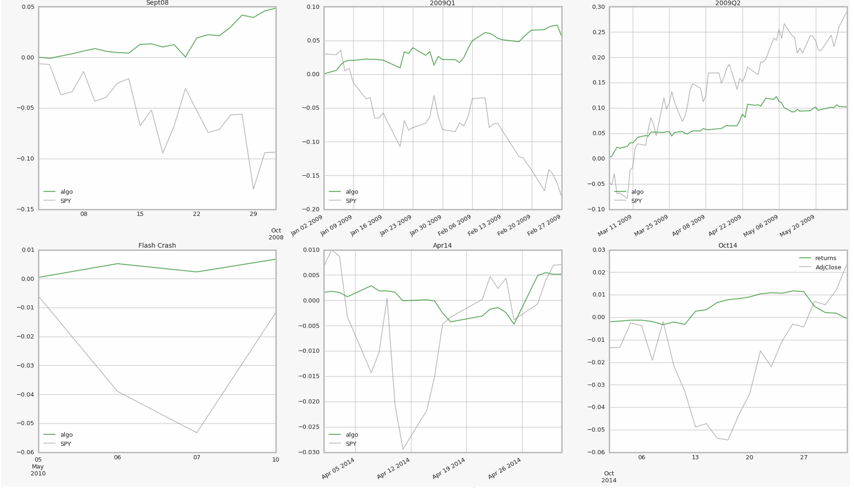
Tear sheet analysis
Financial crisis periods:

Slide 33
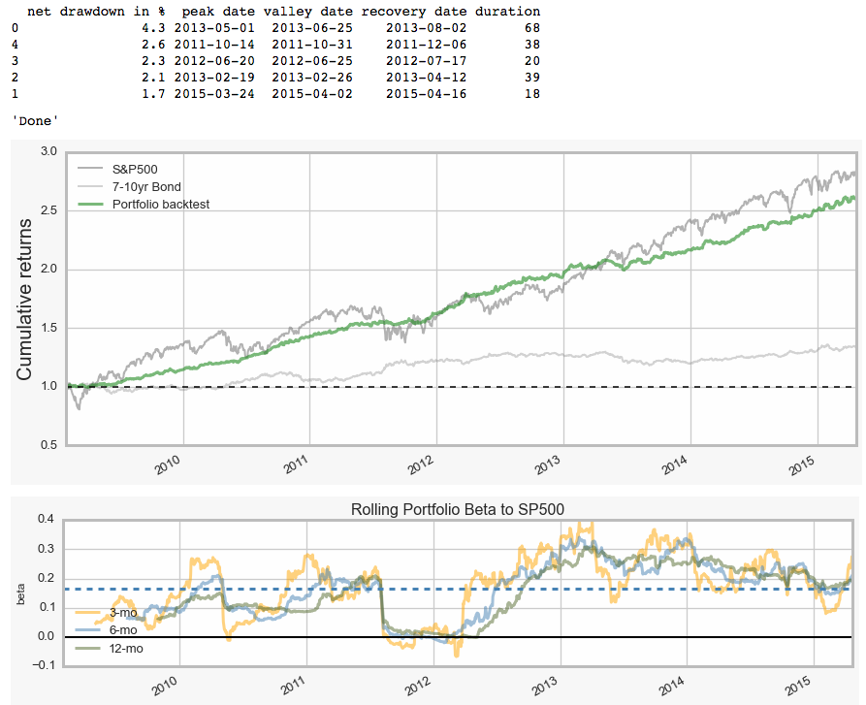
Combining top-down screening with bottom-up tear sheet analysis vetting looks particularly promising.

Slide 34
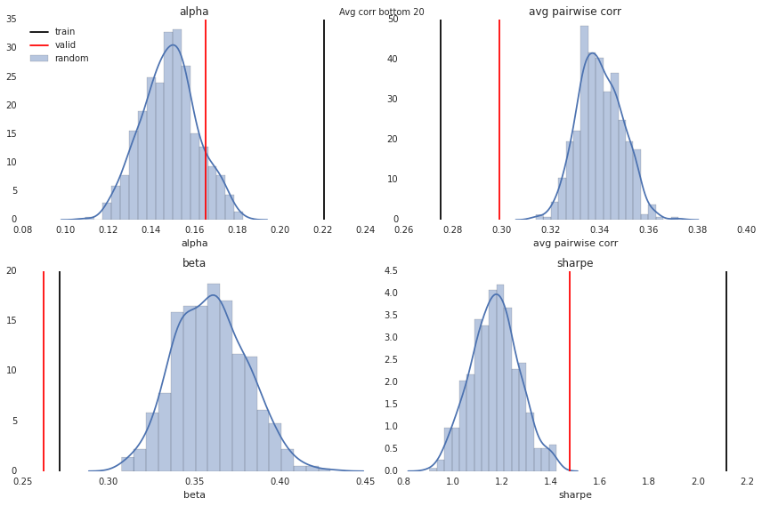
Correlation Qualification
In-sample walk-forward model results, 115 algorithms submitted to January Quantopian Open paper trading competition. Backtested time range: 2002-2012

Slide 35
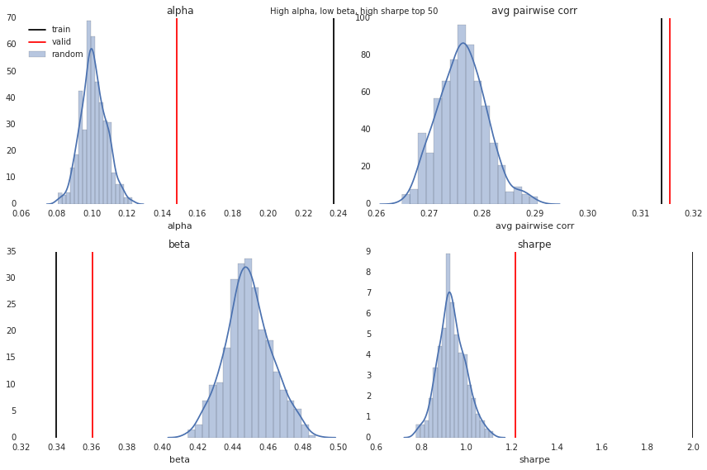
Performance Qualification
In-sample walk-forward model results, 115 algorithms submitted to January Quantopian Open paper trading competition. Backtested time range: 2002-2012

Slide 36
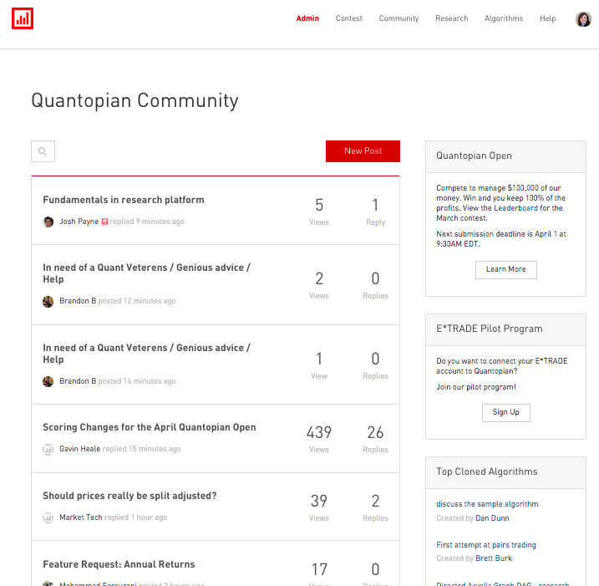
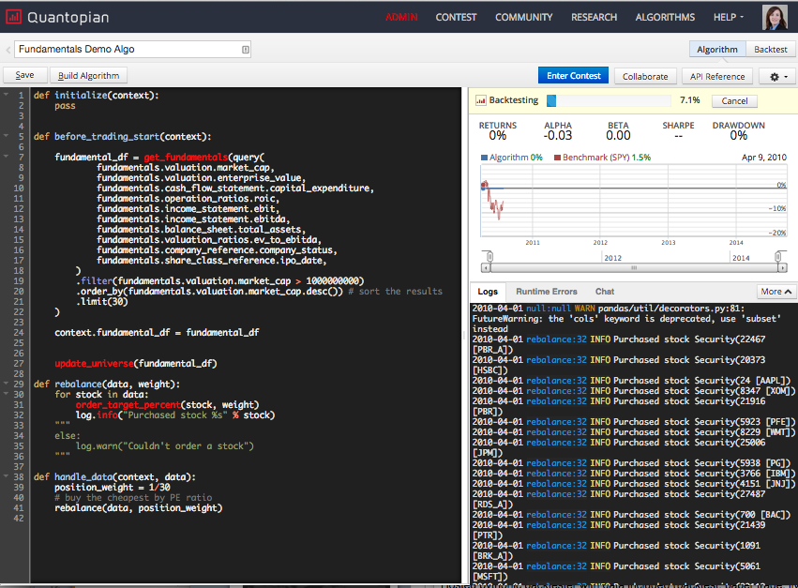
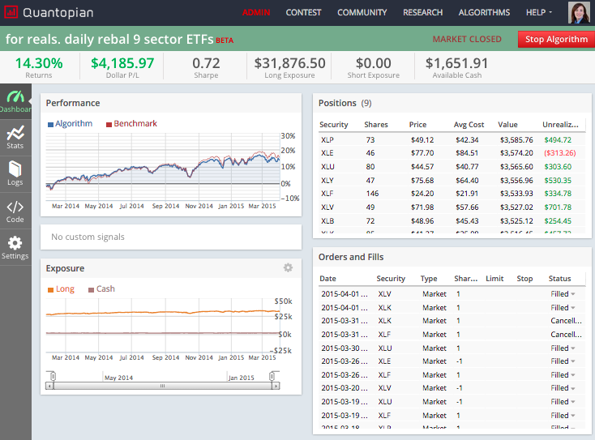
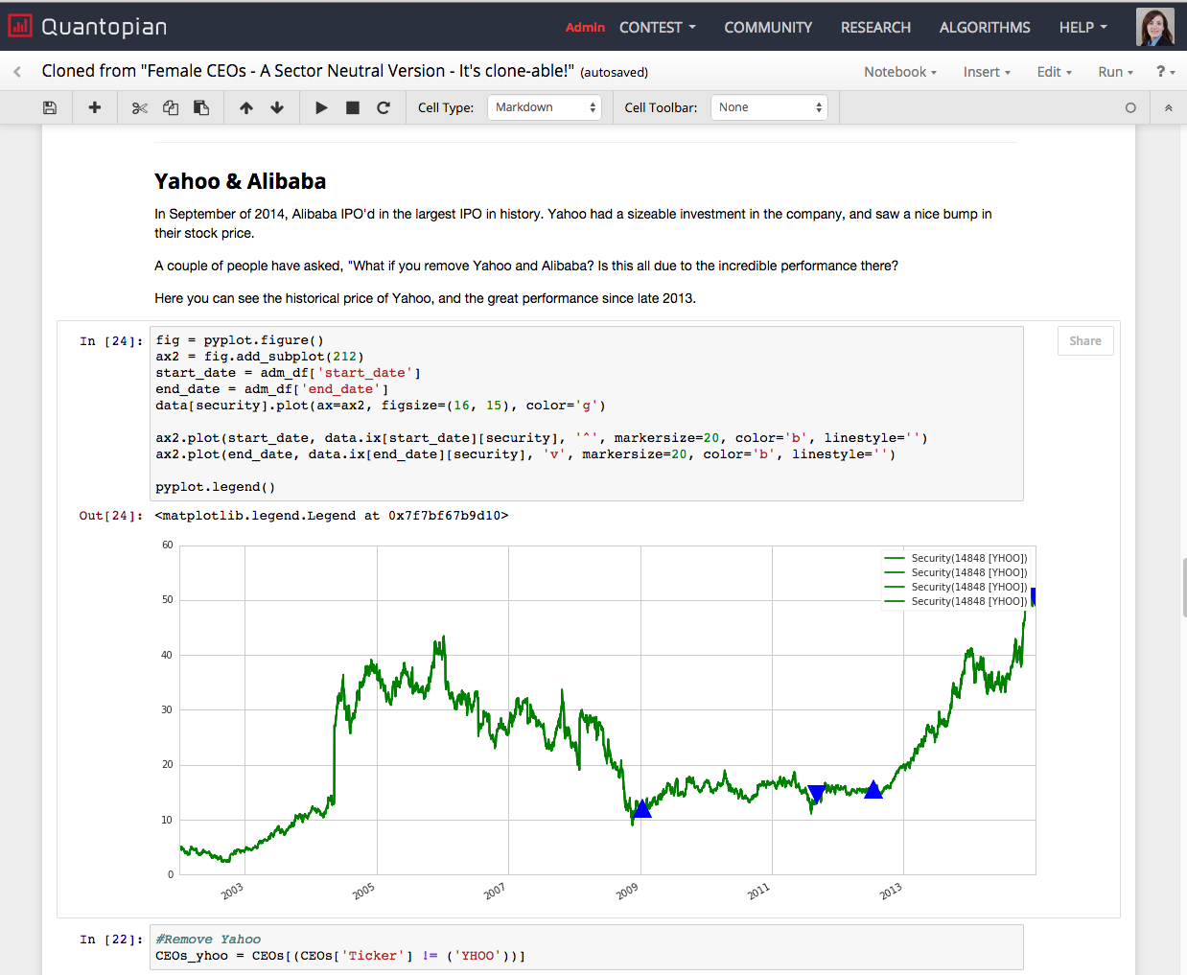
Notes:
1. Quantopian has built the world’s largest online quant community
2. Started with a hosted pythonic backtester (open source project: Zipline)
3. Added integration to live trade in January 2014 (integration with IB and soon E*Trade)
4. Launched a hosted research environment for data exploration and signal development

